Slide 1
Project NOBLE
Projecting Strikes Against Ukrainian Infrastructure with Markov Transitions
Earp, Mason, Dallas, Ryan
Egl, Hannah Lumpkin, Bree

Slide 2
Notes
The full code, all matrices and tables, and answers to the prompted questions can be found in the accompanying Jupyter notebook.
Claude was used to troubleshoot code, but no code written by Claude was used for the simulation (i.e., code written by Claude for troubleshooting was removed after bugs were identified). Therefore, Claude’s only influence is the adjustment of pre-existing code originally based on Assignment 5 and course content downloaded from the course GitHub.

Slide 3
Target Variables
oblast
rayon
type_of_infrastructure

Slide 4
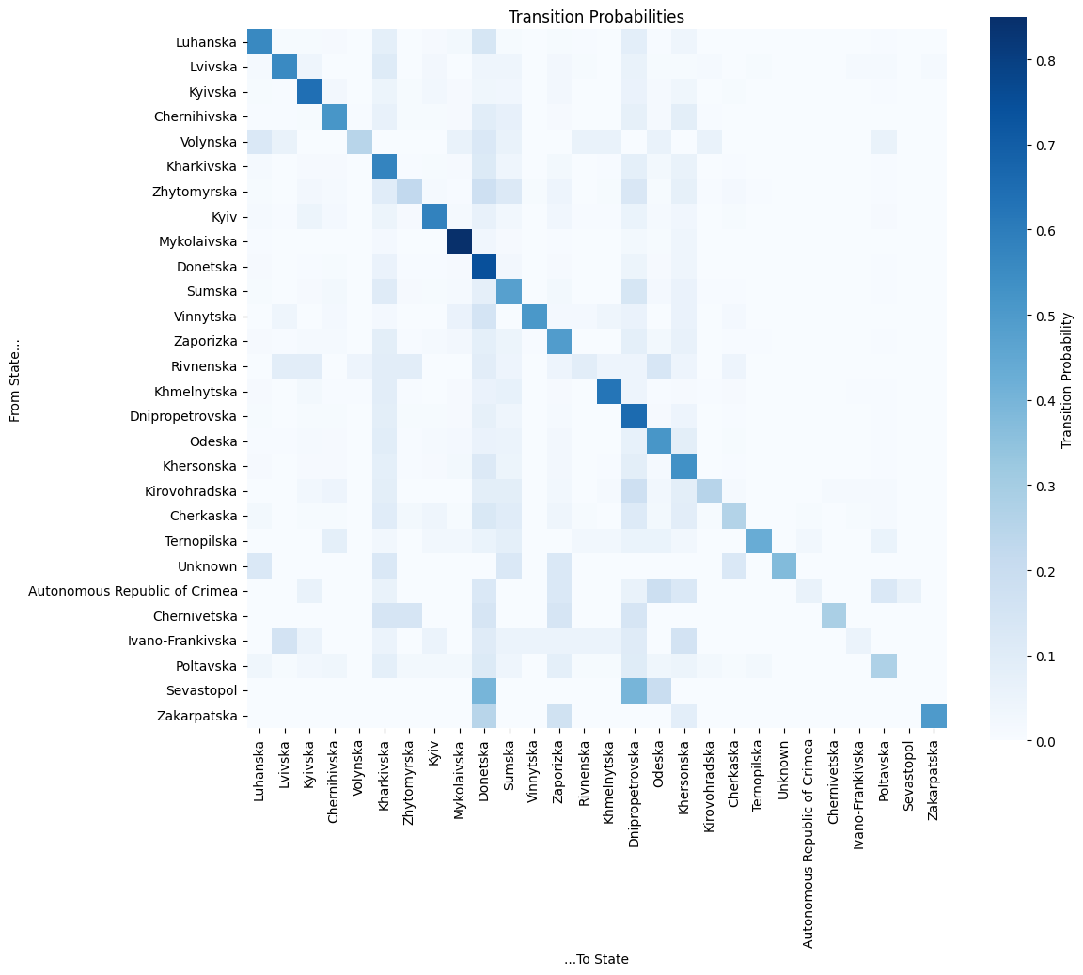
Markov Transition Heatmap
Oblast
Sources/Origin
  Row of Heatmap
Destinations
  Column of Heatmap

Slide 5
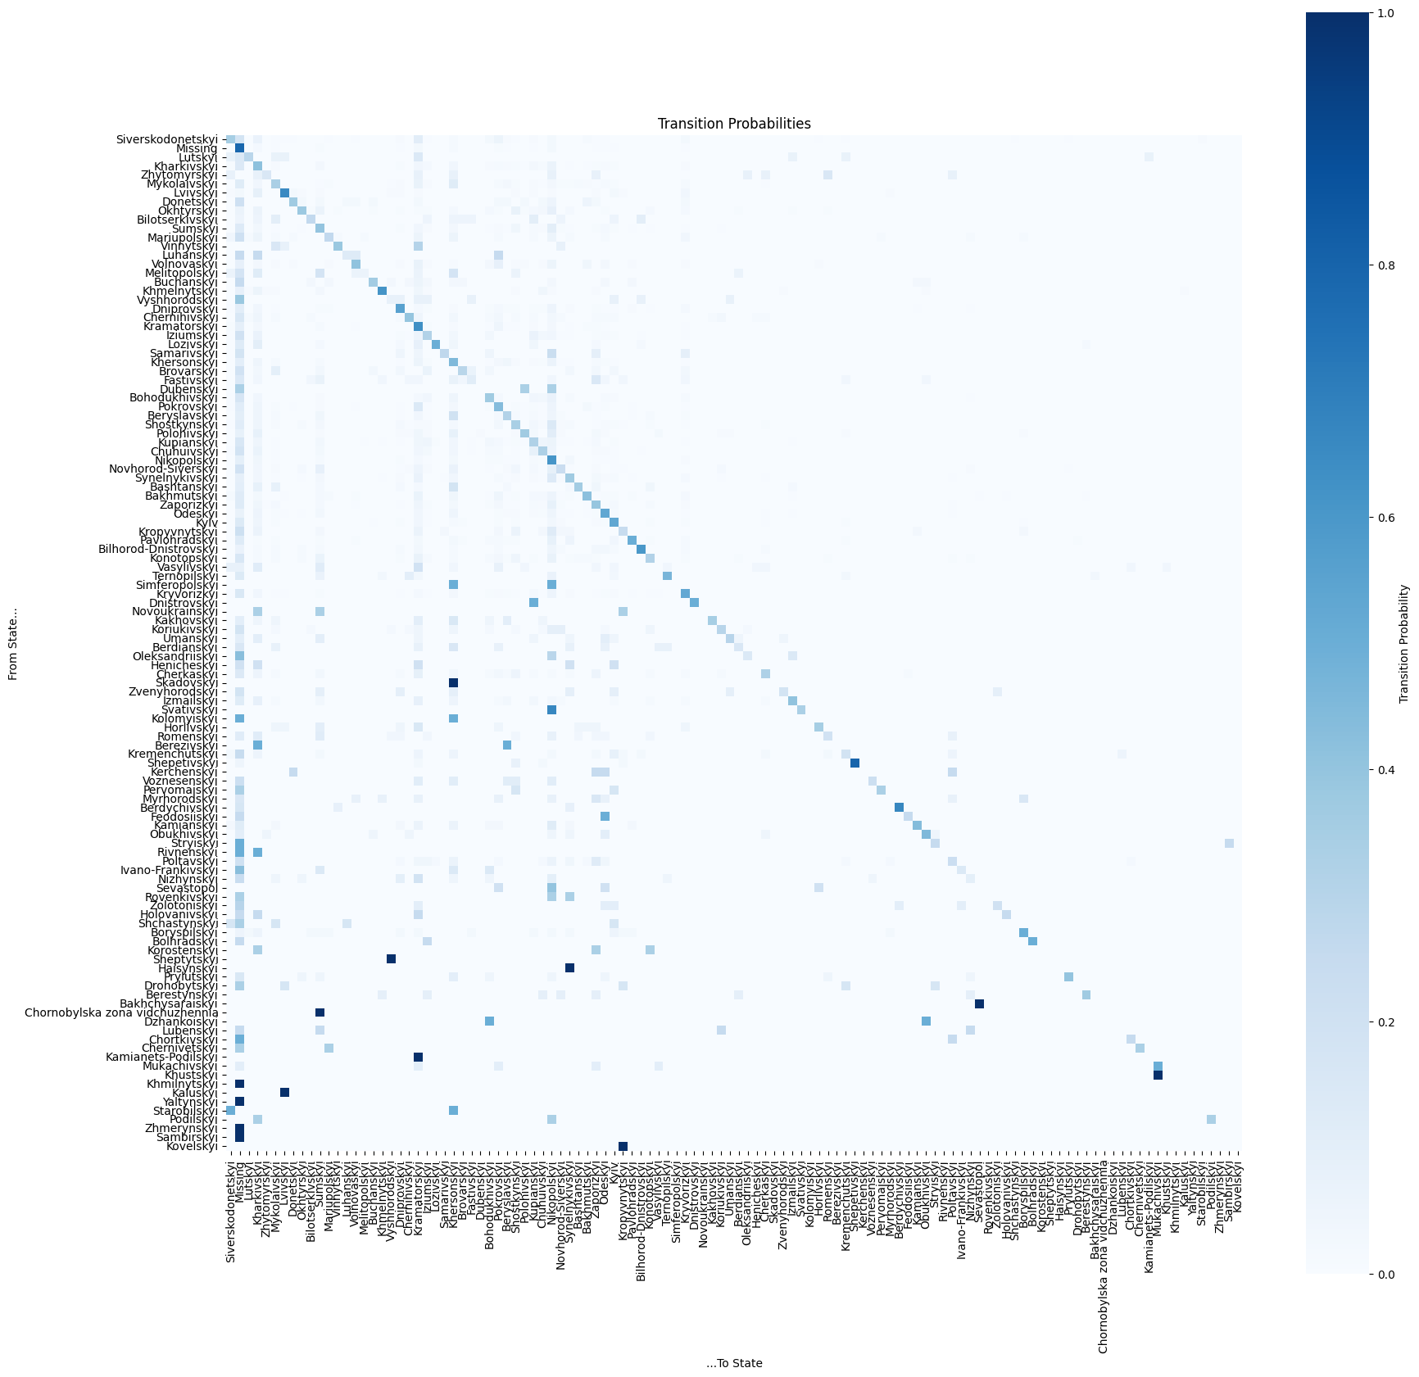
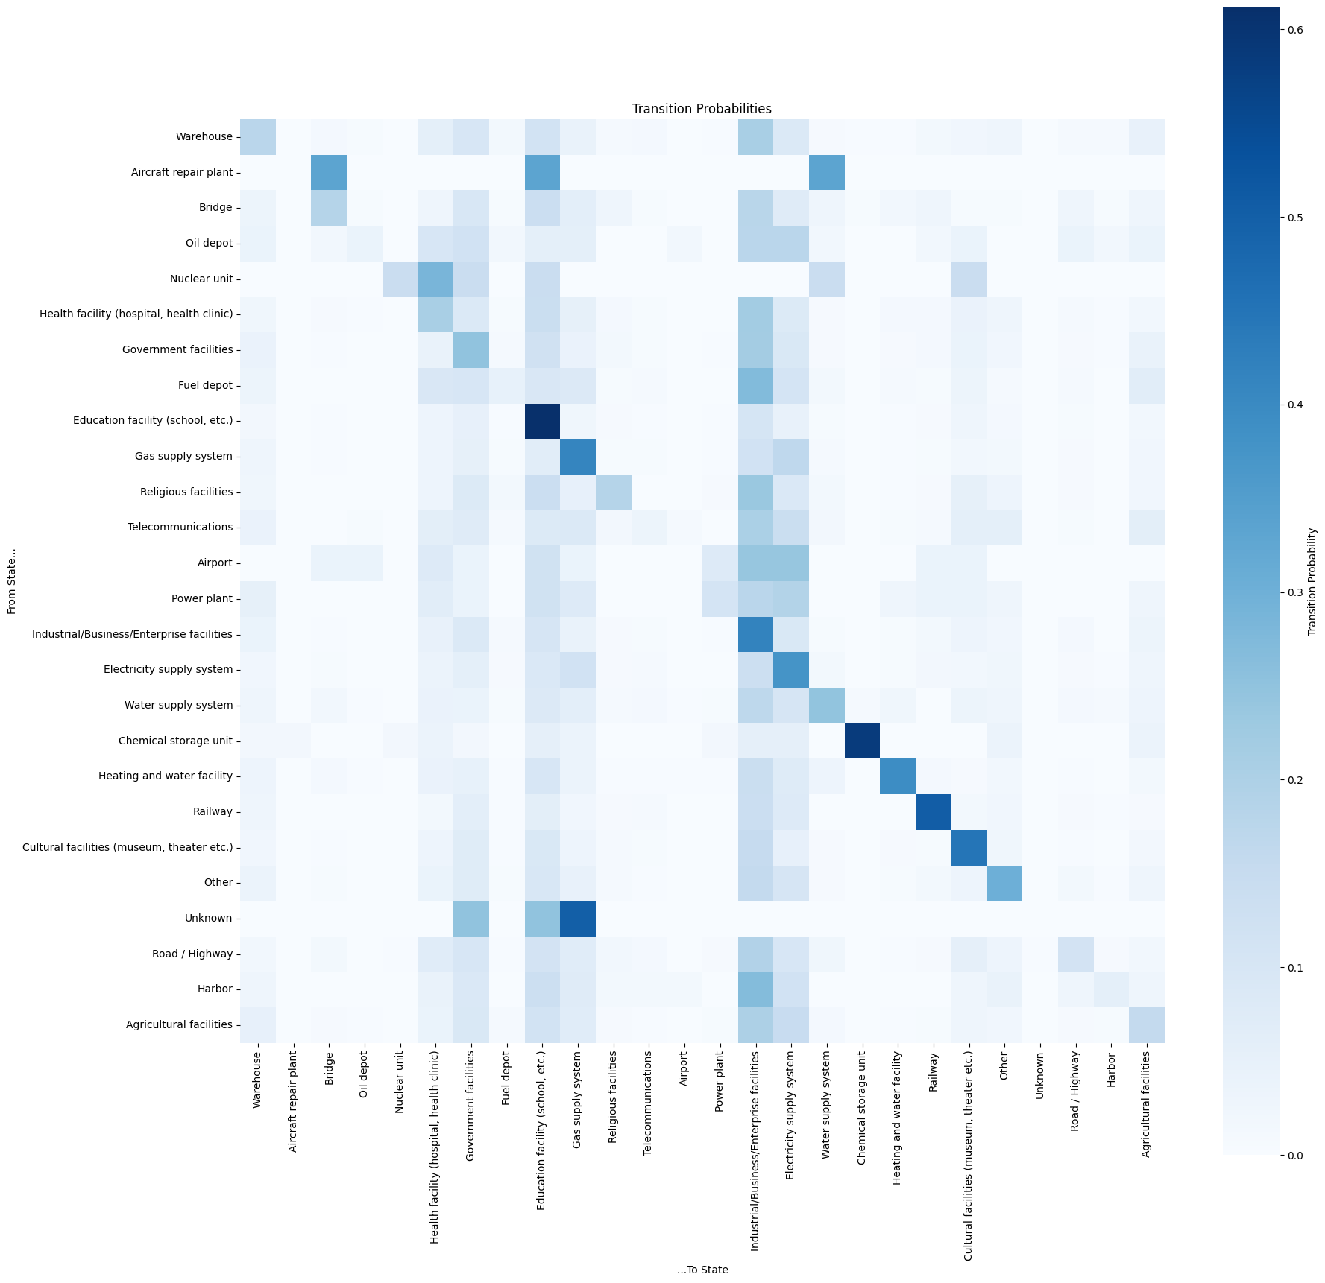
Rayon Heatmap
Infrastructure Heatmap

Slide 6
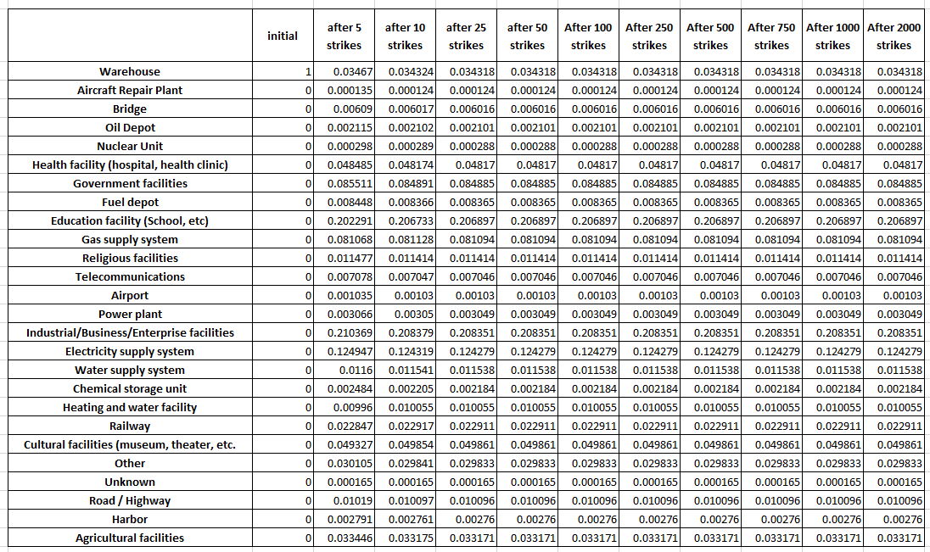
Results
Infrastructure Markov Projection Numbers
Full tables can be found in the accompanying notebook

Slide 7
Results (2) - Oblasts
Strikes in Donetska: 0.2512
Strikes in Donetska : 0.2512
Strikes in Kharkivska: 0.1398
Strikes in Dnipopetrovska: 0.1670
Strikes in Kharkivska : 0.1398
Strikes in Dnipopetrovska : 0.1670

Slide 8
Results (3) - Rayons
Strikes in “Missing”: 0.3593
Strikes in “Missing”: 0.3593
Strikes in Kramatorskyi : 0.0937
Strikes in Kramatorskyi: 0.0937
Strikes in Nikopolskyi : 0.1020
Strikes in Nikopolskyi: 0.1020

Slide 9
Results (4) - Infrastructure
After approx. 25 strikes, Industrial targets settle out to 0.2084, Educational Facilities to 0.2069
Electricity Supply targets: 0.1243
Government targets: 0.0849,
Gas Supply targets: 0.0811

Slide 10
Results (5) – Infrastructure, Recoded
After approx. 15 strikes, Civilian targets settle out to 0.3234
Business targets: 0.2427
Power & Fuel targets: 0.2427

Slide 11
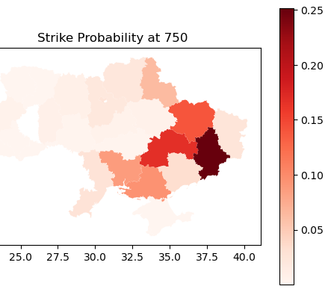
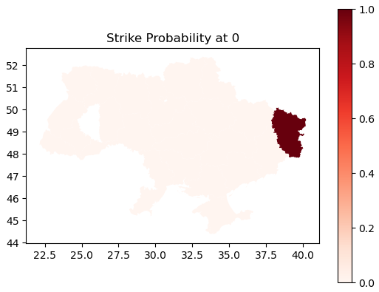
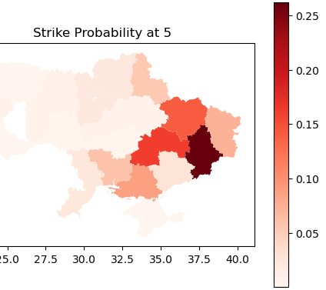
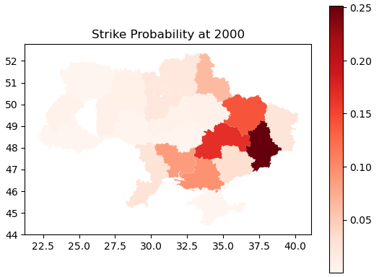
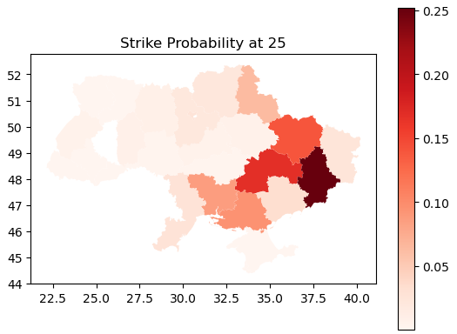
Expansion
(geo data)
Visualizing the probabilities across Oblasts (states) after t number of strikes
Visualization and geocoding completed via Geopandas package and QGIS

Slide 12

